Slide 1


EARNINGS MANAGEMENT
Submitted By:
Nawaf Masoudi NAB046
Ali Redah Al-Sihati SC0009
Mosleh Al – Shaker NBB117

Slide 2

In International Accounting Standards Board (IASB) Framework for financial reporting (IASB, 2010) states that “providing financial information about the reporting entity that is useful to existing and potential investors, lenders and other creditors in making decisions about providing resources to the entity”

Slide 3

"Earning management" generally focuses on artificially increasing (or decreasing) the income, earnings, or earnings per share figures through aggressive accounting tactics.

Slide 4
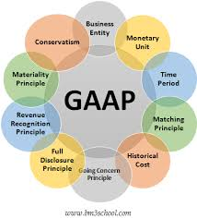
GAAP
Financial statements are first affected by business structuring decisions that involve the business in economic activities. These decisions result in transactions or changes in value that must then be recorded in accordance with generally accepted accounting principles (GAAP).

Slide 5
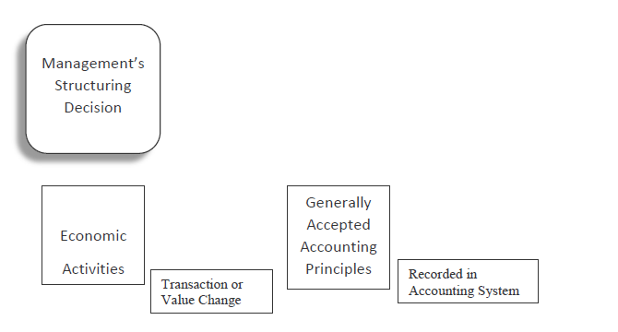
Business Structuring Decisions versus Financial Reporting Decisions

Slide 6
Financial reporting judgments that could subtly shade earnings in one direction or another
Long-term construction contracts require estimates of progress towards completion and costs to be completed. Managers Could Use Optimistic Estimates Of Progress Towards Completion To Boost Profits.
Depreciation calculations require estimates of useful life and protection values. Managers can assess the optimism of life, use the hedging value of depreciation assets and reduce depreciation costs.
Accounts receivable must be declared at their net realizable value. Managers could use optimistic collection estimates to exaggerate earnings.

Slide 7

Motivations for falsifying financial reporting
Meet the expectations of external profits of analysts and others.
Achieve internal financial goals or improve the appearance of the business.
Conceal the deterioration of the company's financial situation.
Increase the share price.
Strengthen the financial position for the financing of capital or outstanding debt.
Increase the compensation of the administration by achieving bonus objectives and a greater appreciation of the shares.
Cover misappropriated assets for personal benefit.

Slide 8
The COSO special report identified the most common financial fraud techniques among the 347 fraud companies to include
Incorrect revenue recognition 61%
Overvaluation of assets 51%
Underestimation of expenses / responsibilities 14%
consider negotiating also cited 24%
Disguised use of transactions with related parties 18%
Other miscellaneous techniques 20%
* Totals greater than 100% due to multiple abuses

Slide 9


Judgment, Estimates and Earnings Management
The accounting, structural and critical elections must be carried out within the framework of GAAP.
Bad debt estimation is an excellent example of an accounting decision that many managers must make.
Even small changes in estimates can have significant effects on reported earnings

Slide 10
The Difficulty of Identifying Earnings Management
A commonly accepted evaluation of earnings management is that it is good at reducing lucidity by concealing the ‘true’ earnings of a company.
Quantity of the earnings is the main focus of aggressive and deceptive accounting they place less significance comparing with the quality earnings.
Regulators consider earnings management harmful and require immediate remedial action.
standard setters must keep pace with rapid changes in business practices to avoid recognition of accounting being delayed by economic events and to minimize the possibility of creative accounting practices.

Slide 11

Selected Earnings Management Case Examples
The Microsoft Case
Microsoft did not recognize the product as a result of the US Attorney General's antitrust investigation. This is perhaps an example of very conservative unacceptable profit management depicting that not all profit management practices involve exaggeration. The Securities and Exchange Commission (SEC) considers Microsoft's accounting practices to be significantly misdiagnosed from July 1994 to June 1998.

Slide 12

The Time Warner Case
Based on management's analysis of sales and returns and bad debt allocations, Time Warner established reserves of $ 2,253 billion and $ 2,229 billion as of December 31, 2009, and 2008, respectively. These estimates represent around 30% of gross receivables in the two years. This may be an example of conservative to neutral profit management.

Slide 13

The Southwest Airlines Case
After the September 11 crisis, Southwest Airlines changed the estimated lifespan of its aircraft from 22 to 27 years because improved maintenance methods allowed the company to get more useful years out of the plane. The change in estimate and its result were disclosed in a note to the financial statements. This may be an example of acceptable neutral to aggressive earnings management

Slide 14

Earning management continuum of ethical financial reporting, highlighting the difficulty of identifying cases of providing incidents that are global in the past decade. it is clear that reform is needed to define the limits of acceptable accounting flexibility and the balance between principles-based standards. rules-based standards are insufficiently flexible to react to a problem such as fair value, which often requires considerable judgment from experience, with limited market data.

Slide 15
REFERENCES
Cyran, R., Currie, A., & Cox, R. (2011). Fuzzy accounting enriches Groupon. NYTimes.com,June 12. Available at: http://www.nytimes.com/2011/06/13/business/13views.htmlDechow
Jackson, S. B. & Pitman, M. K. (2001). Auditors and earnings management. The CPA Journal, July 2001. Available at: http://www.nysscpa.org/cpajournal/2001/0700/features/f073801.htm.
Kripalani, M. (2009). India’s Madoff? Satyam scandal rocks outsourcing industry. [Electronic version]. Business Week,. January 2009. Available at: http://www.businessweek.com/globalbiz/content/jan2009/gb2009017_807784.htm.

